Slide 1

기말고사 프로젝트
20203723 백재민

Slide 2
팀명 : BJM
목차
1) 프로젝트 소개
2) 필요 부품소개
3) 배선도
4) 회로도
5) 스케치 소스
6) 영상
조원 : 백재민

Slide 3
프로젝트 소개
-크리스마스 무드등-
아두이노와 스마트폰을 블루투스 통신으로 연결한 뒤 앱을 통하여 특정 값을 입력하면 수동부저를 통하여 크리스마스 캐롤송을 출력하고 캐롤송에 맞춰 LED를 깜빡이게 하는 프로젝트 입니다.
캐롤송 없이 무드등으로도 사용가능합니다.

Slide 4
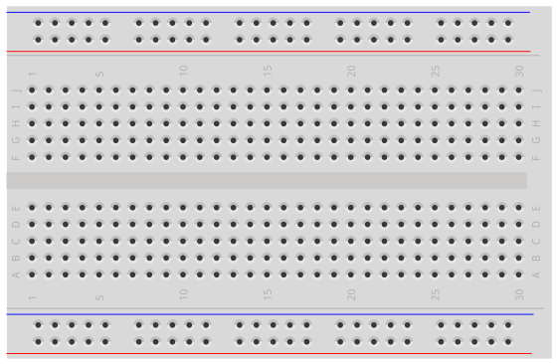
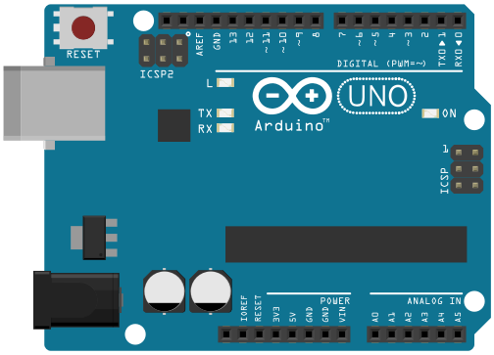

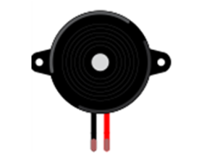
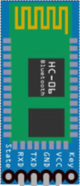





필요 부품
브레드 보드 x 2
아두이노
저항 330Ω
수동부저
HC-06
LED 녹색 x 2
LED 흰색 x 2
LED 빨강 x 2
LED 노랑 x 2
LED 파랑 x 2

Slide 5
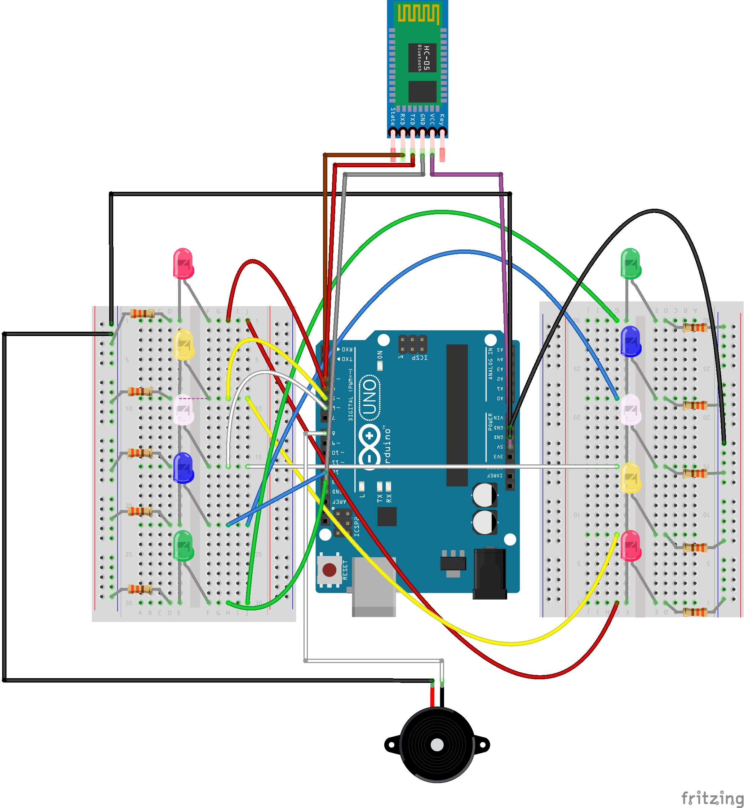
배선도

Slide 6
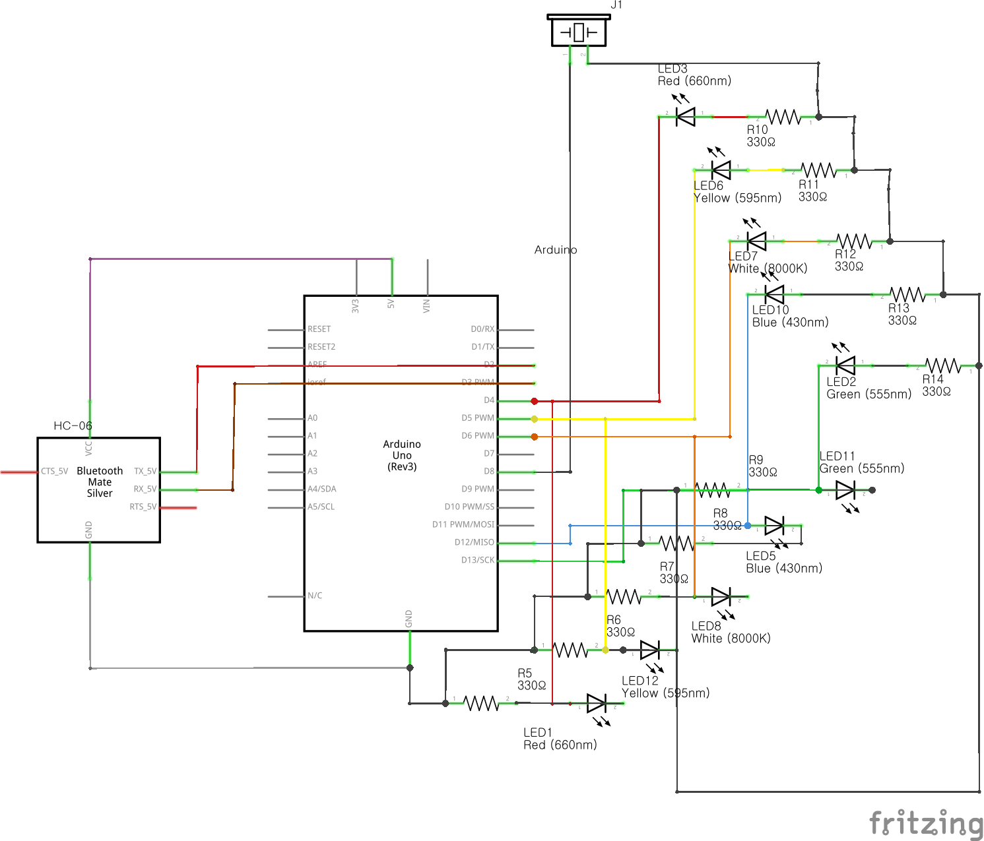
회로도

Slide 7
스케치 코드
/*************************
* Public Constants
* (pitches.h)
*************************/
#define NOTE_B0 31
#define NOTE_C1 33
#define NOTE_CS1 35
#define NOTE_D1 37
#define NOTE_DS1 39
#define NOTE_E1 41
#define NOTE_F1 44
#define NOTE_FS1 46
#define NOTE_G1 49
#define NOTE_GS1 52
#define NOTE_A1 55
#define NOTE_AS1 58
#define NOTE_B1 62
#define NOTE_C2 65
#define NOTE_CS2 69
#define NOTE_D2 73
#define NOTE_DS2 78
#define NOTE_E2 82
#define NOTE_F2 87
#define NOTE_FS2 93
#define NOTE_G2 98
#define NOTE_GS2 104
#define NOTE_A2 110
#define NOTE_AS2 117
#define NOTE_B2 123
#define NOTE_C3 131
#define NOTE_CS3 139
#define NOTE_D3 147
#define NOTE_DS3 156
#define NOTE_E3 165
#define NOTE_F3 175
#define NOTE_FS3 185
#define NOTE_G3 196
#define NOTE_GS3 208
#define NOTE_A3 220
#define NOTE_AS3 233
#define NOTE_B3 247
#define NOTE_C4 262
#define NOTE_CS4 277
#define NOTE_D4 294
#define NOTE_DS4 311
#define NOTE_E4 330
#define NOTE_F4 349
#define NOTE_FS4 370
#define NOTE_G4 392
#define NOTE_GS4 415
#define NOTE_A4 440
#define NOTE_AS4 466
#define NOTE_B4 494
#define NOTE_C5 523
#define NOTE_CS5 554
#define NOTE_D5 587
#define NOTE_DS5 622
#define NOTE_E5 659
#define NOTE_F5 698
#define NOTE_FS5 740
#define NOTE_G5 784
#define NOTE_GS5 831
#define NOTE_A5 880
#define NOTE_AS5 932
#define NOTE_B5 988
#define NOTE_C6 1047
#define NOTE_CS6 1109
#define NOTE_D6 1175
#define NOTE_DS6 1245
#define NOTE_E6 1319
#define NOTE_F6 1397
#define NOTE_FS6 1480
#define NOTE_G6 1568
#define NOTE_GS6 1661
#define NOTE_A6 1760
#define NOTE_AS6 1865
#define NOTE_B6 1976
#define NOTE_C7 2093
#define NOTE_CS7 2217
#define NOTE_D7 2349
#define NOTE_DS7 2489
#define NOTE_E7 2637
#define NOTE_F7 2794
#define NOTE_FS7 2960
#define NOTE_G7 3136
#define NOTE_GS7 3322
#define NOTE_A7 3520
#define NOTE_AS7 3729
#define NOTE_B7 3951
#define NOTE_C8 4186
#define NOTE_CS8 4435
#define NOTE_D8 4699
#define NOTE_DS8 4978

Slide 8
스케치 코드
#include "pitches.h"
#include <SoftwareSerial.h>
#define melodyPin 8
SoftwareSerial mySerial(3, 2);
int led1 = 4;
int led2 = 5;
int led3 = 6;
int led4 = 12;
int led5 = 13;
int counter = 0;
int melody[] = {
NOTE_G4, NOTE_C5, NOTE_C5, NOTE_D5, NOTE_C5, NOTE_B4, NOTE_A4, NOTE_A4, NOTE_A4, NOTE_D5,
NOTE_D5, NOTE_E5, NOTE_D5, NOTE_C5, NOTE_B4, NOTE_G4, NOTE_G4, NOTE_E5, NOTE_E5, NOTE_F5,
NOTE_E5, NOTE_D5, NOTE_C5, NOTE_A4, NOTE_G4, NOTE_G4, NOTE_A4, NOTE_D5, NOTE_B4, NOTE_C5,
NOTE_G4, NOTE_C5, NOTE_C5, NOTE_D5, NOTE_C5, NOTE_B4, NOTE_A4, NOTE_A4, NOTE_A4, NOTE_D5,
NOTE_D5, NOTE_E5, NOTE_D5, NOTE_C5, NOTE_B4, NOTE_G4, NOTE_G4, NOTE_E5, NOTE_E5, NOTE_F5,
NOTE_E5, NOTE_D5, NOTE_C5, NOTE_A4, NOTE_G4, NOTE_G4, NOTE_A4, NOTE_D5, NOTE_B4, NOTE_C5,
NOTE_G4, NOTE_C5, NOTE_C5, NOTE_C5, NOTE_B4, NOTE_B4, NOTE_C5, NOTE_B4, NOTE_A4, NOTE_G4,
NOTE_D5, NOTE_E5, NOTE_D5, NOTE_D5, NOTE_C5, NOTE_C5, NOTE_G5, NOTE_G4, NOTE_G4, NOTE_G4,
NOTE_A4, NOTE_D5, NOTE_B4, NOTE_C5, NOTE_G4, NOTE_C5, NOTE_C5, NOTE_D5, NOTE_C5, NOTE_B4,
NOTE_A4, NOTE_A4, NOTE_A4, NOTE_D5, NOTE_D5, NOTE_E5, NOTE_D5, NOTE_C5, NOTE_B4, NOTE_G4,
NOTE_G4, NOTE_E5, NOTE_E5, NOTE_F5, NOTE_E5, NOTE_D5, NOTE_C5, NOTE_A4, NOTE_G4, NOTE_G4,
NOTE_A4, NOTE_D5, NOTE_B4, NOTE_C5
};
int noteDurations[] = {
3, 3, 4, 4, 4, 4, 3, 3, 3, 3,
4, 4, 4, 4, 3, 3, 3, 3, 4, 4,
4, 4, 3, 3, 4, 4, 3, 3, 3, 2,
3, 3, 4, 4, 4, 4, 3, 3, 3, 3,
4, 4, 4, 4, 3, 3, 3, 3, 4, 4,
4, 4, 3, 3, 4, 4, 3, 3, 3, 2,
3, 3, 3, 3, 2, 3, 3, 3, 3, 2,
3, 3, 4, 4, 4, 4, 3, 3, 4, 4,
3, 3, 3, 2, 3, 3, 4, 4, 4, 4,
3, 3, 3, 3, 4, 4, 4, 4, 3, 3,
3, 3, 4, 4, 4, 4, 3, 3, 4, 4,
3, 3, 3, 2,
};

Slide 9
스케치 코드
int melody2[] = {
NOTE_G4, NOTE_B4, NOTE_D5, NOTE_FS5, NOTE_G5, NOTE_FS5, NOTE_D5, NOTE_B4, NOTE_G4, NOTE_C5,
NOTE_D5, NOTE_G5, NOTE_D5, NOTE_A4, NOTE_G4, NOTE_B4, NOTE_D5, NOTE_FS5, NOTE_G5, NOTE_FS5,
NOTE_E5, NOTE_D5, NOTE_A5, NOTE_G5, NOTE_G5, NOTE_FS5, NOTE_G5, NOTE_FS5, NOTE_E5, NOTE_D5,
NOTE_C5, NOTE_E5, NOTE_G5, NOTE_A5, NOTE_B5, NOTE_A5, NOTE_G5, NOTE_E5, NOTE_B5, NOTE_D6,
NOTE_A5, NOTE_G5, NOTE_A5, NOTE_G5, NOTE_F5, NOTE_DS5, NOTE_G5, NOTE_A5, NOTE_FS5, NOTE_G5,
NOTE_E5, NOTE_FS5, NOTE_E5, NOTE_DS5, NOTE_B5, NOTE_A5, NOTE_A5, NOTE_G5, NOTE_E5, NOTE_FS5,
NOTE_E5, NOTE_DS5, NOTE_D5, NOTE_E5, NOTE_G5, NOTE_D6, NOTE_C6, NOTE_B5, NOTE_A5, NOTE_G5,
NOTE_E5, NOTE_DS5, NOTE_A5, NOTE_B5, NOTE_G5, NOTE_G3, NOTE_B3, NOTE_D4, NOTE_FS4, NOTE_G4,
NOTE_FS4, NOTE_E4, NOTE_D4, NOTE_A4, NOTE_G4, NOTE_G4, NOTE_FS4, NOTE_G4, NOTE_FS4, NOTE_E4,
NOTE_D4, NOTE_E4, NOTE_G4, NOTE_A4, NOTE_B4, NOTE_A4, NOTE_G4, NOTE_E4, NOTE_C4, NOTE_DS4,
NOTE_G4, NOTE_A4, NOTE_AS4, NOTE_A4, NOTE_F4, NOTE_DS4, NOTE_A4, NOTE_G4, NOTE_G4, NOTE_FS4,
NOTE_G4, NOTE_FS4, NOTE_E4, NOTE_D4, NOTE_G3, NOTE_B3, NOTE_D4, NOTE_FS4, NOTE_G4, NOTE_FS4,
NOTE_E4, NOTE_D4, NOTE_B4, NOTE_B4, NOTE_B4, NOTE_A4, NOTE_B4, NOTE_A4, NOTE_G4, NOTE_E4,
NOTE_C4, NOTE_DS4, NOTE_G4, NOTE_A4, NOTE_AS4, NOTE_A4, NOTE_F4, NOTE_DS4, NOTE_G4, NOTE_A4,
NOTE_FS4, NOTE_G4, NOTE_E4, NOTE_FS4, NOTE_E4, NOTE_DS4, NOTE_G4, NOTE_A4, NOTE_FS4, NOTE_G4,
NOTE_E4, NOTE_FS4, NOTE_E4, NOTE_DS4, NOTE_D4, NOTE_E4, NOTE_G4, NOTE_D5, NOTE_C5, NOTE_D5,
NOTE_C5, NOTE_B4, NOTE_A4, NOTE_G4, NOTE_E4, NOTE_D4, NOTE_A4, NOTE_B4, NOTE_G4
};
int noteDurations2[] = {
2.5, 2.5, 2.5, 2.5, 2.5, 2.5, 2.5, 2.5, 2.5, 2.5,
2.5, 2.5, 1.5, 2.5, 2, 2.5, 3, 3, 2.5, 2.5,
2.5, 2, 2, 3, 3, 3, 2.5, 2.5, 2.5, 2.5,
3, 3, 2.5, 3, 2.5, 2.5, 3, 1.5, 3, 3,
2.5, 3, 2.5, 2.5, 3, 2, 2.5, 2.5, 2.5, 3,
2.5, 2.5, 3, 2, 2.5, 3, 2.5, 2.5, 2.5, 2.5,
3, 1.5, 3, 3, 2.5, 2.5, 1, 2.5, 2.5, 2.5,
2.5, 2.5, 2, 2.5, 1, 2.5, 2.5, 2.5, 3, 2.5,
2.5, 2.5, 2, 2.5, 2.5, 3, 2.5, 2.5, 2.5, 3,
1.5, 2.5, 2.5, 3, 2.5, 2.5, 2.5, 2, 2.5, 3,
2, 3, 2.5, 2.5, 2.5, 2, 2.5, 3, 2, 3,
2.5, 2.5, 2.5, 2, 2.5, 3, 2.5, 2.5, 2.5, 2.5,
2.5, 1.5, 3, 3, 2.5, 3, 2.5, 2.5, 2.5, 2,
2.5, 3, 2.5, 2.5, 2.5, 2.5, 3, 2, 2.5, 2.5,
2.5, 3, 2.5, 2.5, 3, 2, 2.5, 2.5, 2.5, 3,
2.5, 2.5, 3, 2, 2.5, 2.5, 3, 2.5, 2.5, 3,
1.5, 2.5, 2.5, 2.5, 2.5, 2.5, 2, 2.5, 1
};

Slide 10
스케치 코드
void setup() {
pinMode(led1, OUTPUT);
pinMode(led2, OUTPUT);
pinMode(led3, OUTPUT);
pinMode(led4, OUTPUT);
pinMode(led5, OUTPUT);
pinMode(melodyPin, OUTPUT);
Serial.begin(9600);
mySerial.begin(9600);
}
void loop() {
char ch = mySerial.read();
if (mySerial.available())
{
Serial.write(mySerial.read());
}
if (ch == '1') {
digitalWrite(led1, HIGH);
delay(600);
digitalWrite(led1, LOW);
delay(800);
digitalWrite(led2, HIGH);
delay(600);
digitalWrite(led2, LOW);
delay(800);
digitalWrite(led3, HIGH);
delay(600);
digitalWrite(led3, LOW);
delay(800);
digitalWrite(led4, HIGH);
delay(600);
digitalWrite(led4, LOW);
delay(800);
digitalWrite(led5, HIGH);
delay(600);
digitalWrite(led5, LOW);
delay(800);
}

Slide 11
스케치 코드
if (ch == '2') {
for (int thisNote = 0; thisNote < 114; thisNote++) {
if (thisNote % 2 == 0) {
digitalWrite(led1, HIGH);
digitalWrite(led2, HIGH);
digitalWrite(led3, HIGH);
digitalWrite(led4, HIGH);
digitalWrite(led5, HIGH);
} else if (thisNote % 2 == 1) {
digitalWrite(led1, LOW);
digitalWrite(led2, LOW);
digitalWrite(led3, LOW);
digitalWrite(led4, LOW);
digitalWrite(led5, LOW);
}
int noteDuration = 1000 / noteDurations[thisNote];
tone(8, melody[thisNote], noteDuration);
int pauseBetweenNotes = noteDuration * 1.30;
delay(pauseBetweenNotes);
noTone(8);
}
}
if (ch == '3') {
for (int thisNote = 0; thisNote < 169; thisNote++) {
if (thisNote % 3 == 0) {
digitalWrite(led1, HIGH);
digitalWrite(led2, HIGH);
digitalWrite(led3, HIGH);
digitalWrite(led4, HIGH);
digitalWrite(led5, HIGH);
delay(200);
digitalWrite(led1, LOW);
digitalWrite(led2, LOW);
digitalWrite(led3, LOW);
digitalWrite(led4, LOW);
digitalWrite(led5, LOW);
} else if (thisNote % 3 == 1) {
digitalWrite(led1, HIGH);
digitalWrite(led2, LOW);
digitalWrite(led3, HIGH);
digitalWrite(led4, LOW);
digitalWrite(led5, HIGH);
} else if (thisNote % 3 == 2) {
digitalWrite(led1, LOW);
digitalWrite(led2, HIGH);
digitalWrite(led3, LOW);
digitalWrite(led4, HIGH);
digitalWrite(led5, LOW);
}
int noteDuration2 = 1000 / noteDurations2[thisNote];
tone(8, melody2[thisNote], noteDuration2);
int pauseBetweenNotes = noteDuration2 * 1.30;
delay(pauseBetweenNotes);
noTone(8);
}
}

Slide 12
스케치 코드
if (ch == '4') {
for (int thisNote = 0; thisNote < 169; thisNote++) {
if (thisNote % 10 == 0) {
digitalWrite(led1, HIGH);
} else if (thisNote % 10 == 1) {
digitalWrite(led2, HIGH);
} else if (thisNote % 10 == 2) {
digitalWrite(led3, HIGH);
} else if (thisNote % 10 == 3) {
digitalWrite(led4, HIGH);
} else if (thisNote % 10 == 4) {
digitalWrite(led5, HIGH);
} else if (thisNote % 10 == 5) {
digitalWrite(led5, LOW);
} else if (thisNote % 10 == 6) {
digitalWrite(led4, LOW);
} else if (thisNote % 10 == 7) {
digitalWrite(led3, LOW);
} else if (thisNote % 10 == 8) {
digitalWrite(led2, LOW);
} else if (thisNote % 10 == 9) {
digitalWrite(led1, LOW);
}
int noteDuration2 = 1000 / noteDurations2[thisNote];
tone(8, melody2[thisNote], noteDuration2);
int pauseBetweenNotes = noteDuration2 * 1.30;
delay(pauseBetweenNotes);
noTone(8);
}
digitalWrite(led1, LOW);
}
if (ch == '0') {
for (int i = 0; i < 10; i++) {
digitalWrite(led1, HIGH);
delay(600);
digitalWrite(led2, HIGH);
delay(600);
digitalWrite(led3, HIGH);
delay(600);
digitalWrite(led4, HIGH);
delay(600);
digitalWrite(led5, HIGH);
delay(800);
digitalWrite(led5, LOW);
delay(600);
digitalWrite(led4, LOW);
delay(600);
digitalWrite(led3, LOW);
delay(600);
digitalWrite(led2, LOW);
delay(600);
digitalWrite(led1, LOW);
delay(800);
}
}
}

Slide 13
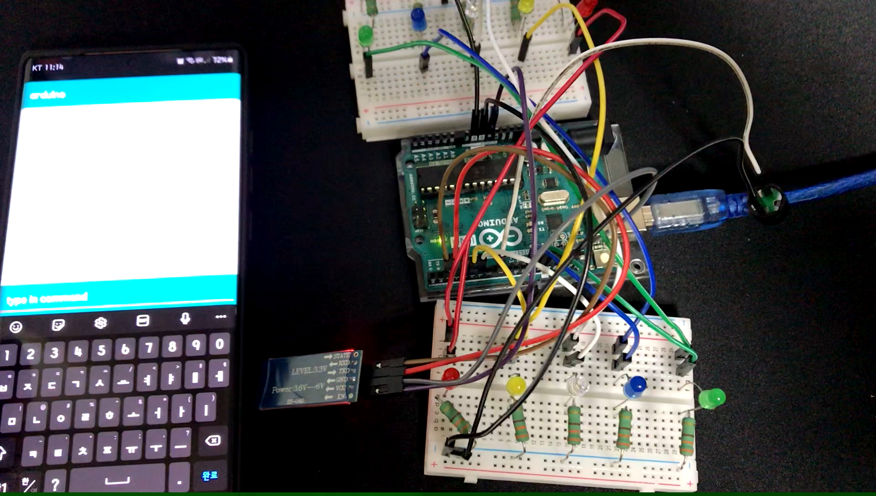
실행결과

Slide 14
감사합니다!

